Slide 1
iBudget (Final Presentation)
The iTeam:
Churk Leung
Vanya Dineva
Quan Pham
Jonathan Reimels
Laurene Assayah
Vladimir Velev
Keeping your information private while letting us make sense of your expenses.

Slide 2
What is iBudget?
A web-based personal financial management service designed to:
Keep track of all your financial accounts into one place
Allow you to set a budget
Manage individual transactions

Slide 3

Competition: Mint.com
See all accounts
Auto categorization
Timely alerts to email and phone
Helpful graphs

Slide 4
Competitive Advantage
iBudget
Does NOT require:
A secure connection to a financial institution
Login credentials to a financial institution
Requires:
Account credentials to financial institutions

Slide 5
Project Organization Process Model: Unified Process
 | Phase 1 | Phase 2 | Phase 3 | Phase 4
Planning
Requirements Analysis
Implementation
Testing

Slide 6
Project Organization
Member | Team Leader | CM Leader | QA Leader | Requirements Management Leader | Design Leader | Implementation Leader
Document Responsibility | SPMP | SCMP | SQAP STP | SRS | SDD | Code Base

Slide 7
Management Process: Management Objectives and Priorities
The completion of the project on time before the end of the school semester
Meeting a degree of quality as specified at the beginning of the project
Complete as many requirements as were planned at the beginning of the project

Slide 8
Management Process: Risk Management
# | Risk Title | Likelihood to Occur 1-10 | Impact 1-10 | Retirement Cost 1-10 | Priority | Retirement or Mitigation Plan | Responsible Engineer | Target Completion Date
1 | Requirements Inflation | 3 | 8 | 2 | 48 | Add additional features depending on time. | All | 04/02
2 | Poor Productivity | 7 | 10 | 10 | 40 | Keep developers engaged and motivated. | Project Leader | 04/30
3 | Shortfalls in 3rd party software | 4 | 3 | 6 | 336 | Analyze software capabilities in advance. | TBD | 04/15
4 | Insufficient time | 8 | 9 | 5 | 30 | Follow schedule. | Project Leader | 04/30
5 | Unforeseen software defects | 7 | 7 | 5 | 45 | Allocate enough time for defect resolution. | All | 04/16

Slide 9
Management Process: Monitoring and controlling mechanism
Weekly project meetings on Monday @ 5 PM
Weekly reports completed by each team member

Slide 10
Management Process: Staffing Plan
Name | Team Leader | CM Leader | QA Leader | Requirement Management Leader | Design Leader | Implementation Leader
Vladimir Velev | X
Jonathan Reimels |  | X
Vanya Dineva |  |  | X
Laurene Assayah |  |  |  | X
Churk Leung |  |  |  |  | X
Quan Pham |  |  |  |  |  | X

Slide 11
Budget and resource allocation
Estimate LOC:
FP = (∑UFP_i)*GCF
UFP_i = 3 (EI) + 4 (EO) + 3 (EIN) + 7 (ILF) + 5 (ELF) = 22
GCF = 0.65 + 0.01 * 42 = 1.07
FP = 23.54
LOC = 23.54 * (600 LOC/FP) = 14 KLOC
COCOMOI:
Effort Applied (E) = 3.0 * (14)^1.12 = 57 man-months
Development Time (D) = 2.5 * (57)^0.38 = 11 months
People required (P) = 57/11 = 6

Slide 12
Schedule
Design | Mon 2/13/12 | Mon 3/19/12
Review preliminary software specifications | Mon 2/13/12 | Mon 3/12/12 | Churk Y. Leung,Jonathan Reimels,Laurene Assayah,Quan Pham,Vanya Dineva,Vladimir Velev
Develop functional specifications - front end | Tue 2/14/12 | Fri 3/23/12 | Vanya Dineva,Quan Pham
Develop functional specifications - back end | Sat 2/18/12 | Mon 4/16/12 | Churk Y. Leung,Jonathan Reimels
Review functional specifications | Mon 2/27/12 | Fri 4/27/12 | Laurene Assayah,Vladimir Velev
Design complete | Fri 4/27/12 | Fri 4/27/12
Development | Mon 2/27/12 | Fri 4/27/12
Identify modular/tiered design parameters | Mon 2/27/12 | Mon 3/19/12 | Churk Y. Leung
Develop code | Mon 2/27/12 | Fri 4/20/12 | Churk Y. Leung,Jonathan Reimels,Quan Pham,Vanya Dineva
Developer testing (primary debugging) | Mon 3/5/12 | Fri 4/27/12 | Churk Y. Leung,Jonathan Reimels,Laurene Assayah,Quan Pham,Vanya Dineva,Vladimir Velev
Development complete | Fri 4/27/12 | Fri 4/27/12
Testing | Mon 4/2/12 | Mon 4/16/12
Develop test plans | Mon 4/2/12 | Mon 4/9/12 | Vanya Dineva,Laurene Assayah
Review test plans | Mon 4/9/12 | Mon 4/16/12 | Churk Y. Leung,Jonathan Reimels,Quan Pham,Vladimir Velev
Implement Test Plans | Mon 4/9/12 | Mon 4/16/12 | Vanya Dineva,Laurene Assayah
Unit testing complete | Mon 4/16/12 | Mon 4/16/12

Slide 13
Configuration Management and Version Control
Google Project Hosting
Contain all project documents
Configuration summary will be managed in the project wiki
http://code.google.com/p/cs679-b1-class-project/w/list
svn (from Google Project Hosting)
Used to control versions of all project documents

Slide 14
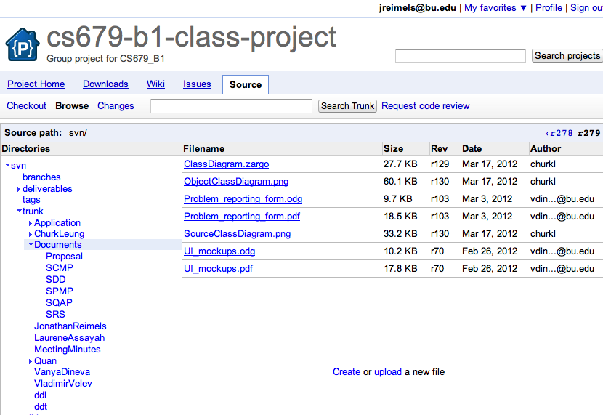
Managing Documents and Code (svn)

Slide 15
Functional Requirements
Create an account
Log In / Log out
Edit profile information (password, name)
Upload CSV file
Handle budgets, categories and transactions

Slide 16
Non-Functional Requirements
Consistent look for different browsers
Enforce strong password
End of session
Maintainability, portability
Performance

Slide 17
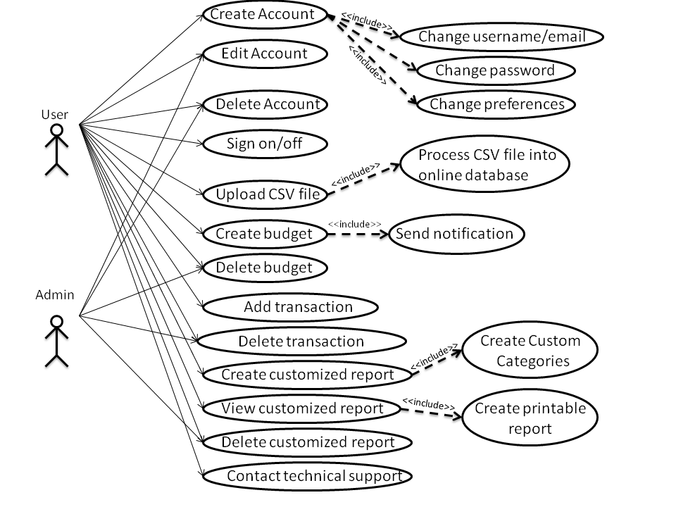
Use Case Diagram

Slide 18
Software Quality
Each team member responsible for the quality of his/her work
Each project artifact was inspected by at least 2 reviewers before submission
Set of coding standards
Google code issue tracker used for issues

Slide 19
Bug Tracking
Bugs will be tracked in the project wiki:
http://code.google.com/p/cs679-b1-class project/issues/list
Criteria
Example
ID
Type
Status
Priority
Owner
Summary
ID: 14
Type: Defect
Status: Accepted
Priority: Critical
Owner: churkl
Summary: Category on transactions are not loaded correctly

Slide 20
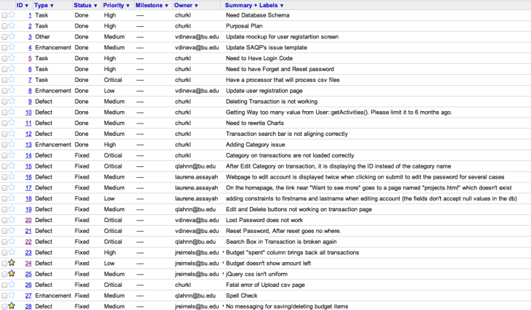
Bug Tracking

Slide 21
Time spent

Slide 22
What could we have done better?
Better task allocation
Pair programming
Unit tests

Slide 23
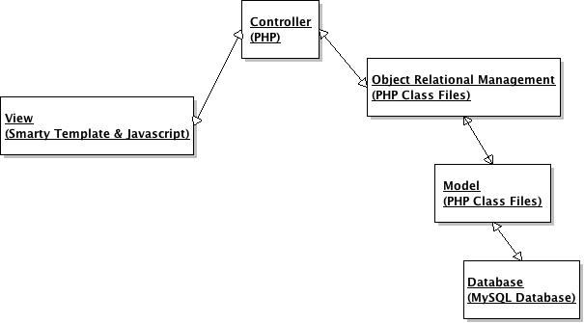
System Architecture MVC with ORM Layer
Notes:
The model manages the behavior and data of the application domain, responds to requests for information about its state (usually from the view), and responds to instructions to change state (usually from the controller). The model is not necessarily merely a database; the 'model' in MVC is both the data and the business/domain logic needed to manipulate the data.
The view renders the model into a form suitable for interaction, typically a user interface element. Multiple views can exist for a single model for different purposes.
The controller receives user input and initiates a response by making calls on model objects. A controller accepts input from the user and instructs the model and a view port to perform actions based on that input.

Slide 24
Design Patterns
Factory: All Application Objects (ORM Objects)
Singleton: All Source Objects
Observer: Being use by JavaScript such as on click or on change events which activates an ajax call to perform a specific task.

Slide 25
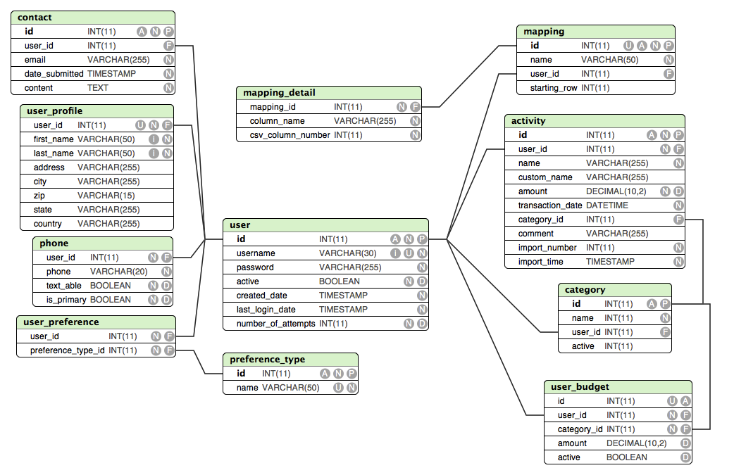
Data Description
A = Auto Increment; N = NOT NULL; P = Primary Key
U = Unique; I = Indexed; D = Has default value assigned
F = Foreign Key

Slide 26
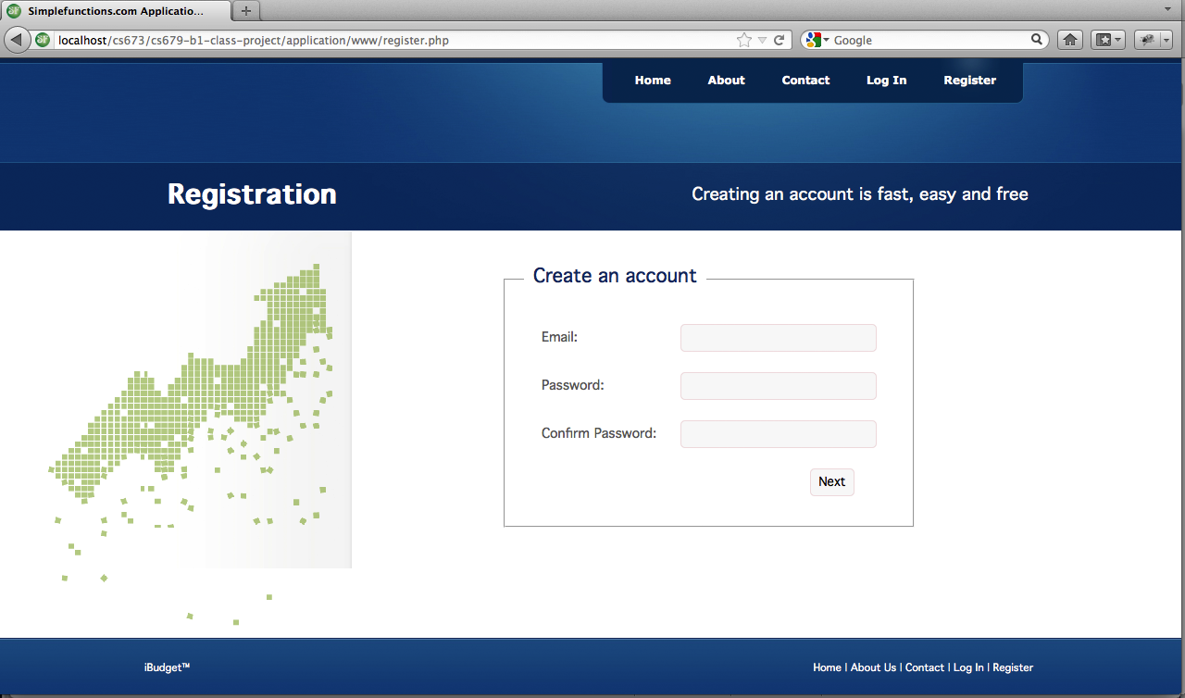
Human Interface Design

Slide 27
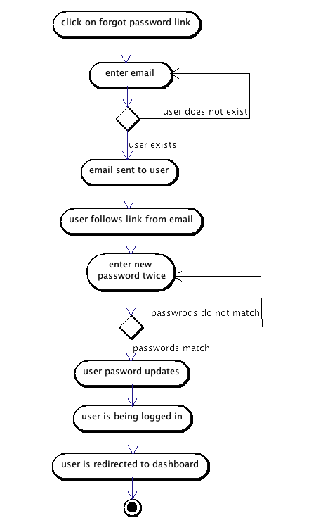
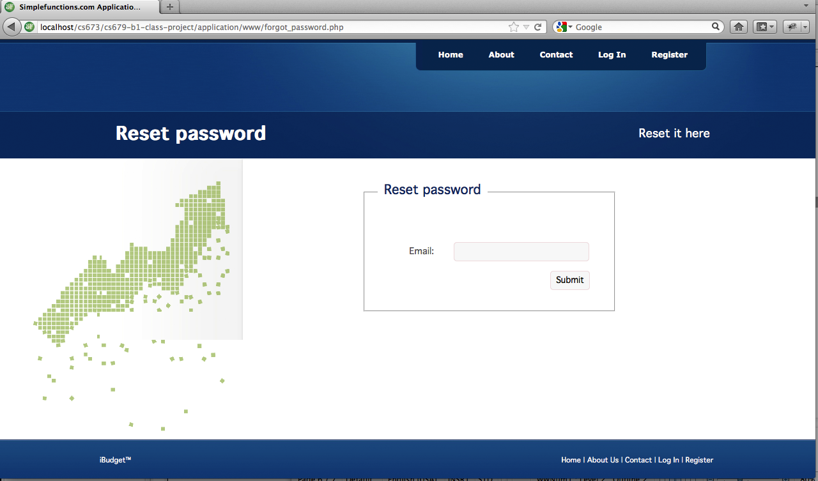
Human Interface Design

Slide 28
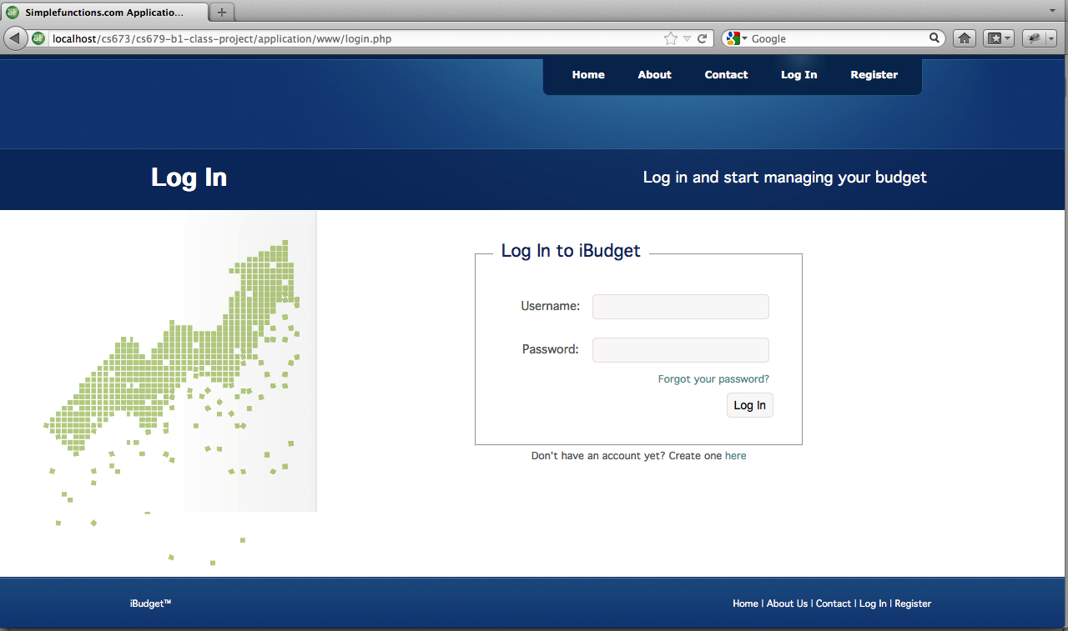
Human Interface Design

Slide 29
Human Interface Design Dashboard View

Slide 30
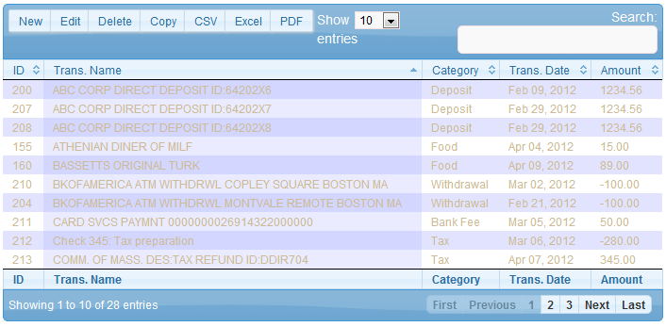
Human Interface Design Transaction View

Slide 31
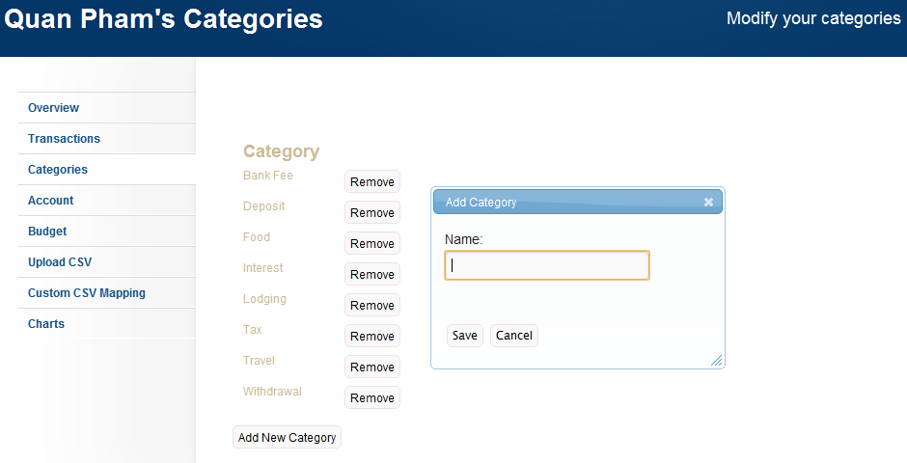
Human Interface Design

Slide 32
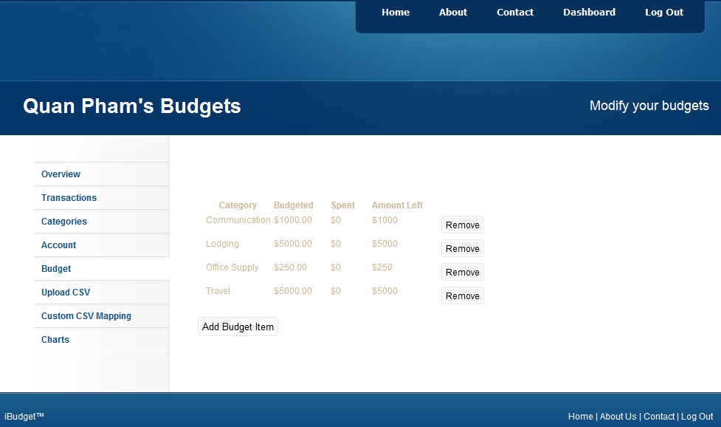
Human Interface Design

Slide 33
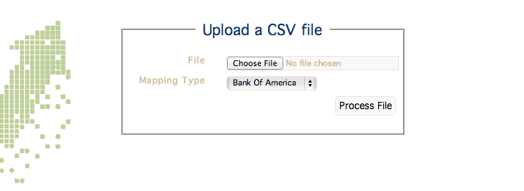
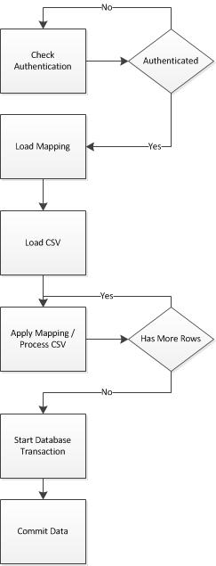
Human Interface Design

Slide 34

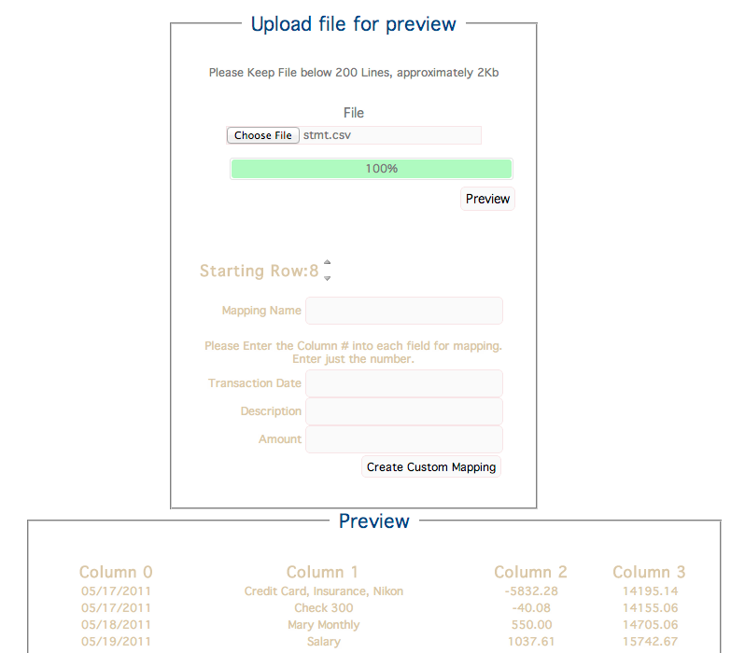
Human Interface Design

Slide 35
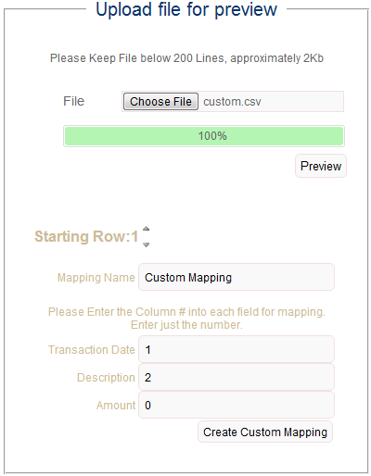
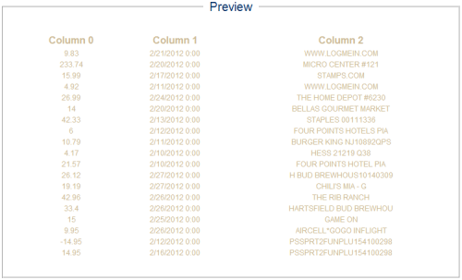
Human Interface Design Custom CSV Mapping

Slide 36
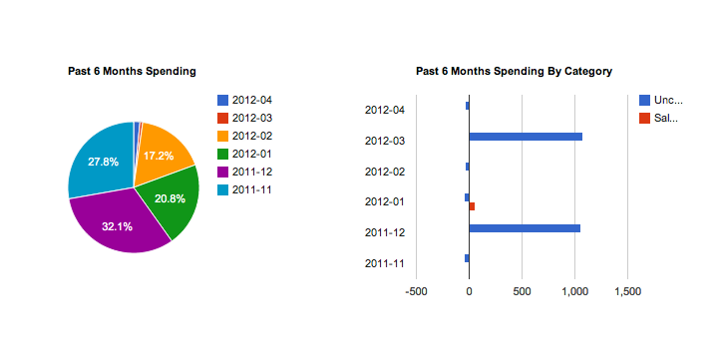
Human Interface Design

Slide 37
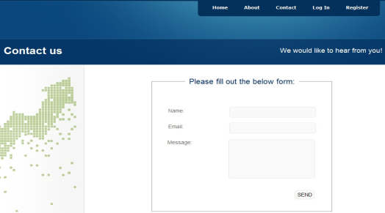
Human Interface Design

Slide 38

Online Demonstration
http://ibudget.simplefunctions.com

Slide 39
Q & A

